Slide 1
Curriculum and technology:
Today and tomorrow
STEPHANIE PEBORDE BURKE
KERRY MAGRO
VERONICA O’NEILL
LASZLO POKORNY

Slide 2
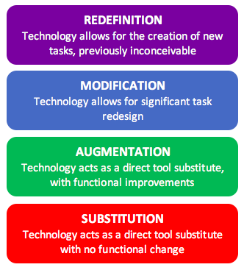
SAMR Model
R
M
A
S
MODEL DEVELOPED BY DR. RUBEN PUENTEDURA

Slide 3
Primary school
"Technology can become the “wings” that will allow the educational world to fly farther and faster than ever before—if we will allow it." - Jenny Arledge

Slide 4
Using the samr model to integrate technologies in Four Major subject areas
SAMR allows teachers to evaluate how they are using technology
SAMR forces educators to view technology as part of a strategy to achieve improved learning outcomes
SAMR forces educators to see themselves as central to the effective use of technology in the classroom

Slide 5
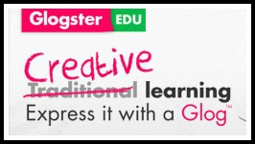


SCIENCE
SCIENCE: GLACIERS | Research and present information on glaciers. | Explore glaciers virtually and interview glacier explorers to obtain a better understanding of glacier geology.
REDEFINITION Introduce tasks that are inconceivable without the technology. |  | Students explore glaciers with Google Expeditions, then create and conduct an interview with a glacier scientist or geologist via Skype Education .
MODIFICATION Technology allows for significant task redesign. | Design a presentation poster using Glogster and have students interact online by posting comments. Embed onto a blog or wiki.
AUGMENTATION Technology is a substitute with functional improvements. | Create a presentation using Microsoft PowerPoint including embedded images and hyperlinks.
SUBSTITUTION Technology is a substitute with no functional change. | Typing the assignment on Microsoft Word rather than written by hand.

Slide 6
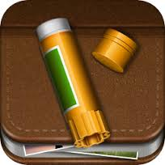



History
HISTORY: PROHIBITION | Research and report on the causes and effects of prohibition. | Determine what was the impact of prohibition on American society.
REDEFINITION Introduce tasks that are inconceivable without the technology. |  | Create and interactive timeline using readwritethink, and use Story Creator to create digital stories for timeline entries.
MODIFICATION Technology allows for significant task redesign. | Create a timeline and post to kidblog to interact with peers and teacher online.
AUGMENTATION Technology is a substitute with functional improvements. | Use timerime to create a timeline including video and images of prohibition.
SUBSTITUTION Technology is a substitute with no functional change. | Find prohibition images online and create a timeline of events.

Slide 7
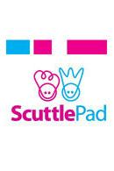

Language arts
LANGUAGE ARTS: CREATIVE WRITING | Students write a story using narrative style. | Students collaborate to compose a story using social media for children.
REDEFINITION Introduce tasks that are inconceivable without the technology. |  | Students use Scuttlepad online to collaboratively compose a story. Students create characters, plot, and narration. All editing is done online. The final product is published online.
MODIFICATION Technology allows for significant task redesign. | Students collaborate to create a story that integrates multimedia tools like Flipbook.
AUGMENTATION Technology is a substitute with functional improvements. | Apply some of the tools in Microsoft Word such as spellcheck and thesaurus.
SUBSTITUTION Technology is a substitute with no functional change. | Typing the assignment on Microsoft Word rather than written by hand.

Slide 8
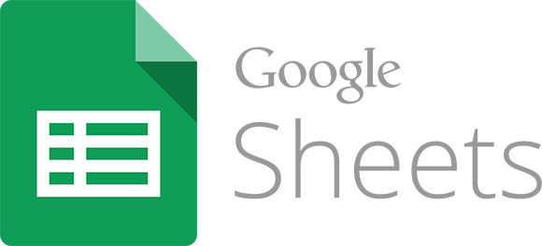

Math
MATH: FRACTIONS | Demonstrate an understanding of fractions by coloring in the blocks. | Determine your own strengths, weaknesses and proficiency level in fractions.
REDEFINITION Introduce tasks that are inconceivable without the technology. |  | Students use Dreambox, an adaptive learning math program that maximizes the challenge to each student and presents unique problems to each student according to their own strengths and abilities.
MODIFICATION Technology allows for significant task redesign. | Students use Adapted Mind online fraction tutorials and use Google Sheets to create their own fraction worksheets.
AUGMENTATION Technology is a substitute with functional improvements. | Students use Google Sheets to color in the blocks and teacher provides feedback directly via Google Sheets.
SUBSTITUTION Technology is a substitute with no functional change. | Students use MS Excel to color in the blocks.

Slide 9
Secondary Education
“Technology ushers in fundamental structural changes that can be integral to achieving significant improvements in productivity. Used to support both teaching and learning, technology infuses classrooms with digital learning tools, such as computers and hand held devices; expands course offerings, experiences, and learning materials; supports learning 24 hours a day, 7 days a week; builds 21stcentury skills; increases student engagement and motivation; and accelerates learning. Technology also has the power to transform teaching by ushering in a new model of connected teaching. This model links teachers to their students and to professional content, resources, and systems to help them improve their own instruction and personalize learning.” (U.S. Department of Education, n.d.)

Slide 10
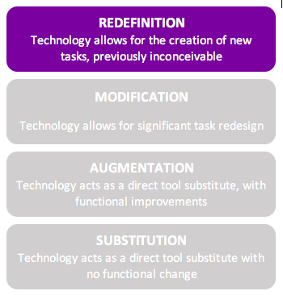
Google EArth
Geographic Information Systems (GIS)
Visit locations you couldn’t possibly travel to as a class
According to WestEd (n.d):
  Study natural and political maps
  Learn map reading and navigation
  Create models
  Go on virtual tours (download or create)
Demirci, Karaburun, & Kilar (2013) found Google Earth to be an effective educational tool for geography lessons
Other sites and games based on Google Earth
  GeoGuessr: https://geoguessr.com/

Slide 11
3D Printing
Create items never before conceived
Common tool in a Makerspace
Thingiverse: http://www.thingiverse.com/
“3D printing puts significant capability into the hands of students, allowing them to answer complex and open-ended questions and demonstrate those answers in three dimensions” (Educause, 2012).
Modeling software
Great for PBLs, ELLs (Hitner, 2016)

Slide 12
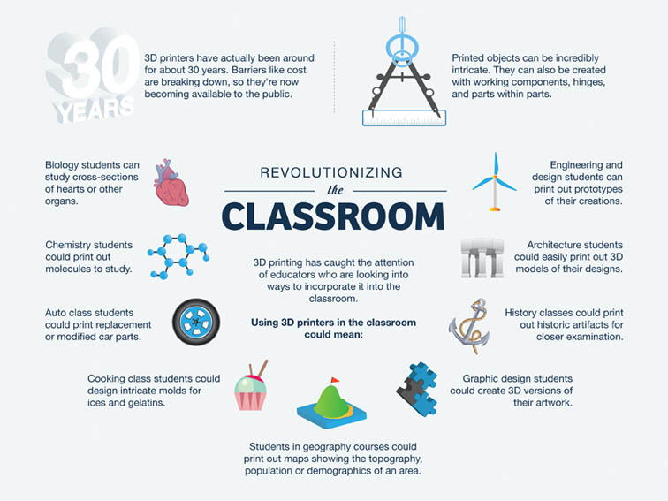
http://www.teachthought.com/the-future-of-learning/technology/10-ways-3d-printing-can-be-used-in-education/

Slide 13
Minecraft
Game-based learning
Engineering and modeling
Applicable to many content areas (Higgin, 2016):
  Create a sustainable world
  Make circuits
  Forms of Government
“…Minecraft is mobilized as an excellent tool that decentralizes instruction, encourages students’ creativity, facilitates collaboration in class, allows for cross-classroom and cross-curricular teaching, addresses some of the needs of diverse students and students who have experienced prior school struggles and may potentially even have therapeutic values for students with learning disabilities“ (Petrov, 2014).

Slide 14
Skype
Web-conferencing
Virtual Field Trips
Visiting places not possible otherwise
  Royal Tyrrell Museum, Alberta, CA:
  http://www.tyrrellmuseum.com/programs/distance/the_royal_tyrrell_museum_virtual_visit.htm
Collaborate with students and classrooms across the globe
“Connecting students from different places and backgrounds is a more personal and interesting way for them to learn about the world beyond their own community than reading a chapter in a textbook. Where the best option available for making those connections was once writing to penpals, Skype makes it possible to make the conversations more direct” (Hicks, 2015).

Slide 15
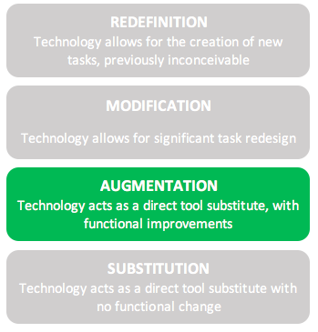
Swivl
Video-recording
Allows students to be independent when recording
Record, critique, reflect
Device alone is Substitution, but can be applied to many more uses
Teacher use vs. student use (Patel, 2014)
  Phys Ed (Walsh, 2015)
Hybrid/blended learning, flipped classrooms
Students as active learners (Kannan & Munday, 2014)

Slide 16
Higher Education
“The number one paradox in higher education is that technology is both transforming and disrupting universities around the world.” (Lucas, 2016).

Slide 17

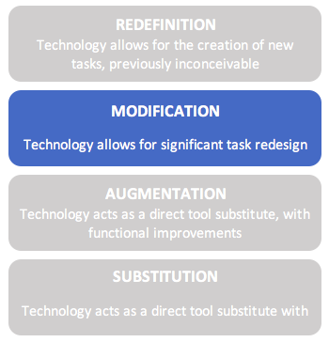
Adaptive placement testing
Traditionally, freshmen take placement tests to enroll in developmental or college level courses
Harper College has students complete an adaptive program, which refreshes and reteaches concepts, then placement test
Placement in college level math courses up from 45.8% prior to the program start, to 74.5% currently
(Levin, 2016)

Slide 18
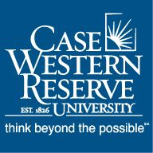

simulation
Traditional simulation enhanced by holographic technology
Case Western Reserve students learn Human Anatomy with Microsoft HoloLens
MediSIM pairs HoloLens with a physical simulator to conduct an actual physical assessment and look at the organs below
(Microsoft HoloLens, 2017; MediSIM, 2017)

Slide 19


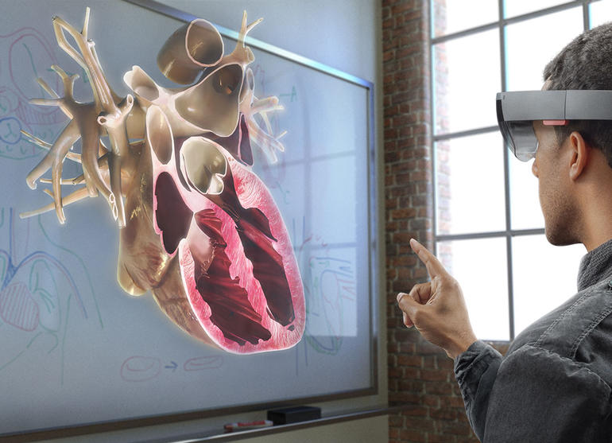
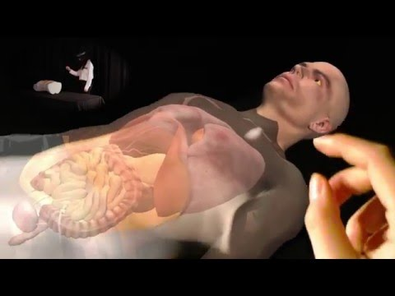

Slide 20
Flipped classroom
According to Ramsey Musallam, flipped teaching is “leveraging technology to appropriately pair the learning activity with the learning environment.” (Tucker, 2012)
Focus on transforming students from consumers to producers
In a study by McGraw-Hill Education, 96% of teachers who have tried a flipped classroom would recommend it to other teachers (Kirby, 2015)

Slide 21


Open educational resources
The Open SUNY Textbook project is offering support to faculty creating new open source materials, and locating, adapting and remixing existing materials
University of Hawaii has a Textbook Zero initiative, working with all of its campuses to adopt no cost textbooks. They use the Pressbooks platform to adapt and author open source materials
(SUNY, n.d.; Watkins, 2017)

Slide 22



Massive online degrees
Georgia Institute of Technology launched an online master’s degree in computer science on the Udacity platform.
Arizona State University has created Global Freshman Academy on the edX platform, offering a full freshman year of General Education courses.
MIT is offering a Master’s of Engineering in Logistics partially on Coursera. Students complete half the program on the MOOC platform, then may move on to the residential program at MIT.
(Rybard, 2013; Straumsheim, 2015a; Straumsheim, 2015b)

Slide 23
Special Education-Exceptional Students
"For people with disabilities, technology makes things easier. For people with disabilities, technology makes things possible.” (IBM) Training Manual ,1991 .

Slide 24
Special education and Educational Technology
# of US SE Students risen 30% in last decade Technology is leveling the playing field
Technological Support: Students have access to the use of computers which include specialized software such as text-to speech, speech-to text, grammar checks, study skills and note-taking programs. For many students with learning disabilities, audiobooks can be an invaluable aid in increasing reading speed and comprehension.
Advantages to Students: Technology has had multiple benefits to help students with special-needs navigate the world around them. Special-needs students who use technology (including but not limited to assistive technology) on a daily basis learn to better self-advocate, gain confidence, challenge themselves; and achieve greater levels of independence.
Advantage to Teachers: Personalize lessons and skill enhancement for each child
(J. Roland, ISTE Journal, How Special Education Technology Improves Learning)
(Heather B. Haynes, Ed Tech Magazine)

Slide 25
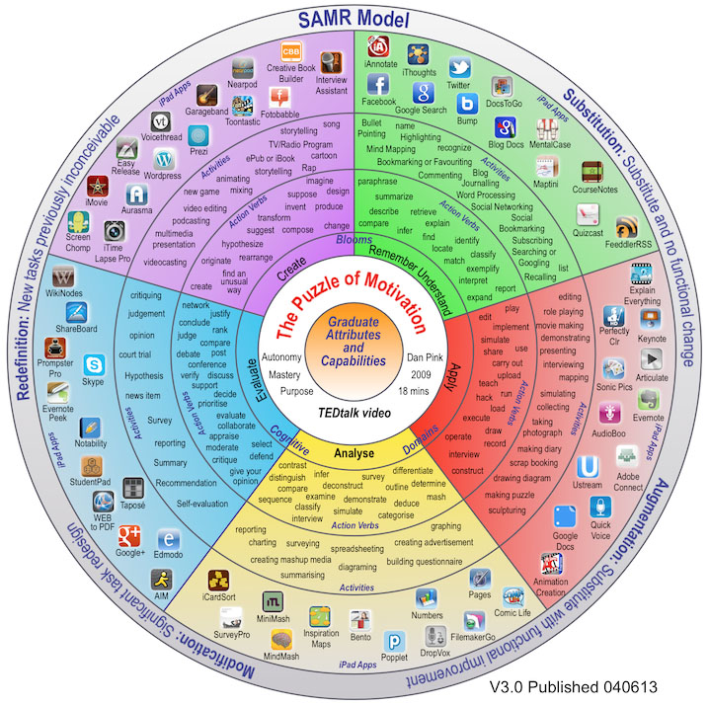
Transforming the Lives of
Special Education Students
With 65 examples of
educational technology
tools and applications
Notes:
Transforming the Lives of Special Education Students

Slide 26

Educating Exceptional Children- Substitution
Tool used for those with learning disabilities and/or are visual learners.
Helps them to organize their thoughts and ideas digitally via a ‘MindMap.’
I thoughts - SUBSTITUTION
Acts as a direct tool substitute with no functional change

Slide 27
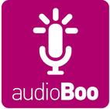
Educating Exceptional Children- Augmentation
In a speech class have students practice language and pronunciation skills and playback to listen to their progress
Augmentation
Acts as a direct tool substitute with functional Improvement

Slide 28


Educating Exceptional Children- Modification –
Tech Allows for significant task redesign
Speak It! Text-to speech app available on iTunes which reads allowed any text that you copy and paste into it’s program. Helps those especially who are nonverbal.
Sources: https://itunes.apple.com/us/app/speak-it!-text-to-speech/id308629295?mt=8
Speak It - Modification
Dragon Dictation
Those who struggle with Dysgraphia and other writing disabilities can use this program
to put their words down on paper without having to write it out by hand.
Sources: National Form Of Special Education Journal, Volume 25, Number 1, 2014 http://www.nationalforum.com/Electronic%20Journal%20Volumes/McCollum,
%20Dixie%20Effects%20of%20a%20Speech-to-Text%20Software%20NFSEJ%20V25%20N1%202014.pdf
Dragon Diction - Modification

Slide 29
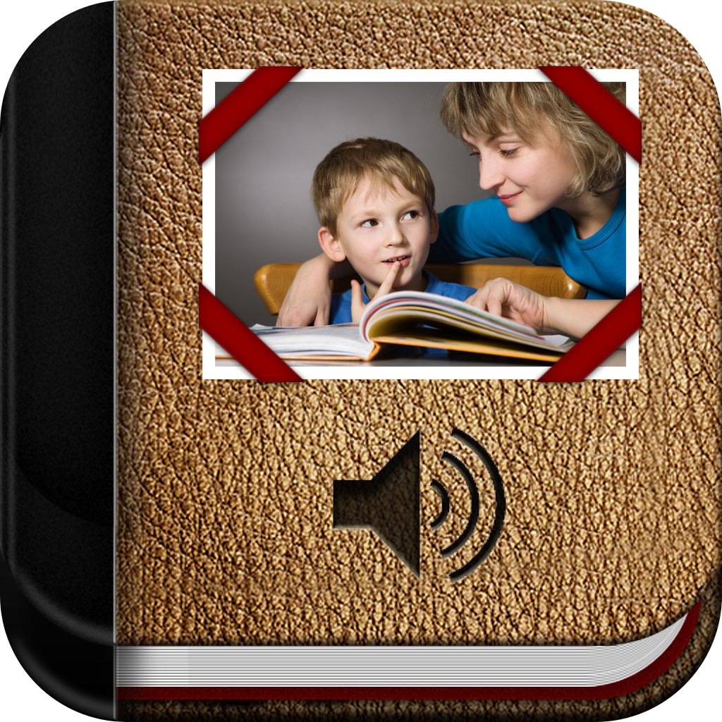

Educating Exceptional Children-Redefinition-
Allows for creation of new tasks previously inconceivable
Pictello
Provides visuals for day to day activities which can include social stories and
visual schedules for those with a wide range of special needs.
Developed by a Speech-Language Pathologist named Jennifer Marden.
Sources: http://www.specialneeds.com/products-and-services/
general-special-needs/special-needs-app-day-pictello
Book Creator
An App created for Ipads that can help build on communication, literacy and numerical skills. Students speak into the device and get to hear their voices as they create their own stories.
Sources: http://bookcreator.com/blog/2013/11/book-creator-breaking-boundaries-special-education-2/
ok Creator

Slide 30
The samr Model
Easy for teachers to understand, and try to reach higher levels of implementation
Lack of theoretical basis; very little peer-reviewed literature
Lack of acknowledgement of the importance of context
Model is rigid, may not focus enough on learning
Focuses on product, not process
Higher levels may not lead to better outcomes, more research is required
(Hamilton, Rosenberg and Akcaoglu, 2016)

Slide 31
Primary Resources
Dumancic, M., & Matijevic, M. (2016). How mobile learning can change education. Online International
Interdisciplinary Research Journal, Volume-VI.
Domingo, M., & Gargante, A. B. (2016). Exploring the use of educational technology in primary education:
teachers’ perception of mobile technology learning impacts and applications’ use in classroom.
Computers in Human Behavior, 56, 21-28.
EdofICTJSSALC. SAMR Examples. Retrieved from: https://edofict.wikispaces.com/SAMR+Examples
Hilton, J. T. (2016). A case study of the application of SAMR and TPACK for reflection on technology
integration into two social studies classrooms. Social Studies, 107(2), 68-73.
Pitchford, N. J., & Outhwaite, L. A. (2016). Can touch screen tablets be used to assess cognitive and motor
skills in early years primary school children? A cross cultural study. Frontiers in Psychology, Volume 7.
Pruet, P., Ang, C. S., & Farzin, D. (2016). Understanding tablet computer usage among primary school
students in underdeveloped areas: Students’ technology experience, learning styles and attitudes.
Computers in Human Behavior, 55, 1131-1144.
Walsh, K. (2015). 8 examples of transforming lessons through the SAMR cycle. Emerging Ed Tech. Retrieved
from: http://www.emergingedtech.com/2015/04/examples-of-transforming-lessons-through-samr/

Slide 32
Secondary Education References
Demirci, A., Karaburun, A., & Kılar, H. (2013). Using Google Earth as an educational tool in secondary school geography lessons. International Research in Geographical and Environmental Education, 22(4), 277-290.
Educause. (2012, July). Things You Should Know About…3D Printing. Retrieved from https://library.educause.edu/~/media/files/library/2012/7/eli7086-pdf.pdf
Hicks, K. (2015, May 9). 6 Creative Ways to Use Skype in the Classroom. Edudemic. Retrieved from http://www.edudemic.com/skype-in-classroom/
Higgin, T. (2016, April 13). Great Minecraft Lesson Plans. Common Sense Education. Retrieved from https://www.commonsense.org/education/blog/great-minecraft-lesson-plans
Hitner, M. (2016, April 27). 3D Printing in Education: Beyond STEM. MatterHackers. Retrieved from https://www.matterhackers.com/articles/3d-printing-in-education-beyond-stem
Kannan, J., & Munday, P. (2014). Student Created Videos in a Spanish Language Course: Promoting Active Learning.

Slide 33
Secondary Education References (continued)
Patel, A. (2014, December 26). 15 Uses for the Swivl. The CoolCatTeacher Blog. Retrieved from http://www.coolcatteacher.com/15-uses-swivl/?nabe=6224726523641856:1&utm_referrer=https%3A%2F%2Fwww.google.com%2F
Petrov, A. (2014). Using Minecraft in Education: A Qualitative Study on Benefits and Challenges of Game-Based Education (Doctoral dissertation, University of Toronto).
U.S. Department of Education. (n.d.). Use of Technology in Teaching and Learning. Retrieved from https://www.ed.gov/oii-news/use-technology-teaching-and-learning
Walsh, K. (2015). 8 Examples of Transforming Lessons Through the SAMR Cycle. EmergingEdTech. Retrieved from http://www.emergingedtech.com/2015/04/examples-of-transforming-lessons-through-samr/
WestEd. (n.d.). Google Earth in the Classroom. Retrieved from https://static.googleusercontent.com/media/www.google.com/en//educators/activities/pdfs_GTA/CribSheet.Earth5.pdf

Slide 34
Higher education references
Kirby, L. (2015). Think flipping the classroom Isn’t for you? Check out the hard data before making any decisions.
Retrieved from http://www.mheducation.com/highered/ideas/educator/think-flipping-the-classroom-isnt-for-you-
check-out-the-hard-data-before-making-any-decisions.html
Levin, D. (2016). Five reasons to value technology in higher education. Retrieved from
https://www.linkedin.com/pulse/five-reasons-value-technology-higher-education-david-levin
Lucas, H. (2016). The higher education technology paradox. Retrieved from
http://www.edtechmagazine.com/higher/article/2016/05/higher-education-technology-paradox
MediSIM (2017). MediSIM. Retrieved from http://www.etc.cmu.edu/projects/medisim/
Microsoft HoloLens (2017). Microsoft HoloLens: Partner spotlight with Case Western Reserve University (video).
Retrieved from https://www.youtube.com/watch?v=SKpKlh1-en0
Rybard, R. (2013) Massive (but not open). Retrieved from
https://www.insidehighered.com/news/2013/05/14/georgia-tech-and-udacity-roll-out-
massive-new-low-cost-degree-program#sthash.vL7pJ7SD.dpbs

Slide 35
Higher education references (continued)
Straumsheim, C. (2015a). MOOCs for (a year’s) credit. Retrieved from
https://www.insidehighered.com/news/2015/04/23/arizona-state-edx-team-offer-freshman-year-online-through-moocs
Straumsheim, C. (2015b). MIT’s new model. Retrieved from
https://www.insidehighered.com/news/2015/10/08/massachusetts-institute-technology-
launch-half-mooc-half-person-masters-degree
SUNY Open Educational Resources Services (n.d.) Retrieved from http://textbooks.opensuny.org/suny-oer-services/
Tucker, C. (2012). Flipped classroom: Beyond the videos. Retrieved from
http://catlintucker.com/2012/04/flipped-classroom-beyond-the-videos/
Watkins, D. (2017) How the University of Hawaii is solving today’s higher ed problems. Retrieved from
https://opensource.com/article/17/2/interview-education-billy-meinke

Slide 36
Educational Resources for Special Education
Assistive Technology: A Parent’s Guide, IBM Training Guide, 1991, retrieved from http://www.disabilityrightsca.org/pubs/Assistive_Technology_Parents_Guide.pdf
IDEA / Special Education retrieved from http://www.nea.org/specialed
Marden, Jennifer, retrieved from http://www.specialneeds.com/products-and-services/general-special-needs/special-needs-app-day-pictello
Marunczpn, Mathieu, Bookcreator: Breaking boundaries in Special Education, 27 November, 2013 http://bookcreator.com/blog/2013/11/book-creator-breaking-boundaries-special-education-2/

Slide 37
Educational Resources for Special Education
Mc McCollum, Dixie, Nation, Steven, Gunn Sharon, The Effects of Speech to Text Software Application on Expression for Students with Various Disabilities, National Forum of Special Education Journal Volume 25, Number 1, 2014 retrieved from http://www.nationalforum.com/Electronic%20Journal%20Volumes/McCollum,%20Dixie%20Effects%20of%20a%20Speech-to-Text%20Software%20NFSEJ%20V25%20N1%202014.
Nieves, Kathyrn, Empowering Special Education Students Thru Technology, Edutopia, retrieved from https://www.edutopia.org/article/empowering-special-education-students-technology-kathryn-nieves
Roland. ISTE Journal, How Special Education Technology Improves Learning 10/7/2015,https://www.iste.org/explore/articleDetail?articleid=568
Shrock, Kathy, The Guide to Everything retrieved from http://www.schrockguide.net/samr.html

Slide 38
Educational Resources for Special Education
Speak It Text to Speech, https://itunes.apple.com/us/app/speak-it!-text-to-speech/id308629295?mt=8
The Padagogy Wheel, http://www.teachthought.com/uncategorized/the-padagogy-wheel-convergent-thinking-in-learning-technology/#Retrived from the Technology Resource Center of Marin
Zorigan, Kris and Job, Jennifer, How do Special education Students benefit from Technology? Retrieved from http://learjnnc.org/lp/pages6917Learn NC

Slide 39
Samr references
Hamilton, E. R., Rosenberg, J. M., & Akcaoglu, M. (2016). The substitution augmentation modification
redefinition (SAMR) model: A critical review and suggestions for its use. TechTrends, 60(5), 433-441.
doi:http://dx.doi.org/10.1007/s11528-016-0091-y
Puentedura, R. (2014a). Building transformation: An introduction to the SAMR model [Blog post].
Retrieved from http://www.hippasus. com/rrpweblog/archives/2014/08/22/BuildingTransformation_
AnIntroductionToSAMR.pdf.

